Slide 1

شبیه سازی فرایند محور
2
دکتر محمد اقدسی
دانشگاه مهر آستان ترم دوم ۹۳-۹۴

Slide 2
تشخیص، ارزیابی و معماری فرایند ها
دکتر محمد اقدسی
بر اساس فصل دوم کتاب
Fundamentals of Business Process Management
Marlon Dumas, Marcello La, Rosa Jan Mendling and Hajo A. Reijers

Slide 3
مباحث این هفته
مقدمه ای بر شبیه سازی،
فراگیری و همه جایی مباحث فرایند. Processes Everywhere
اجزا و عناصر فرایند های کسب و کار Ingredients of a Business Process
منشا دانش مدیریت فرایند و تاریخچه آن Origins and History of BPM
دوره عمر مدیریت فرایند ها وسهم شبیه سازی در آن The BPM Lifecycle

Slide 4
فراگیری و همه جایی مباحث فرایند.
Processes Everywhere

Slide 5
اجزا و عناصر فرایند های کسب و کار
Ingredients of a Business Process

Slide 6
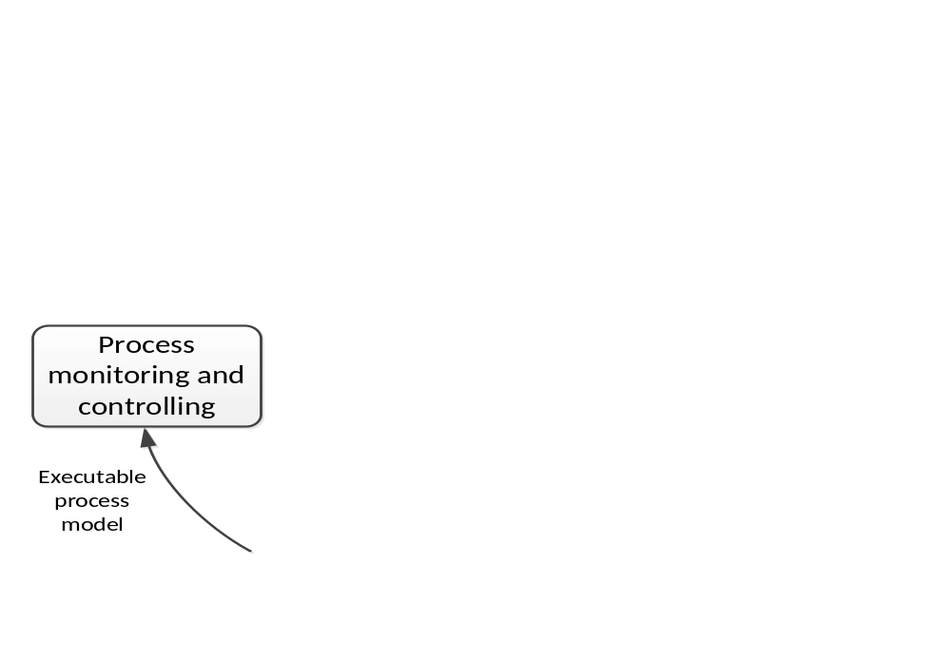
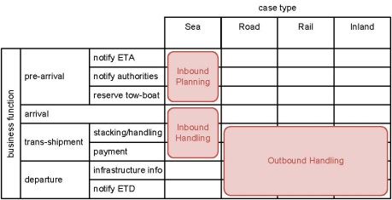
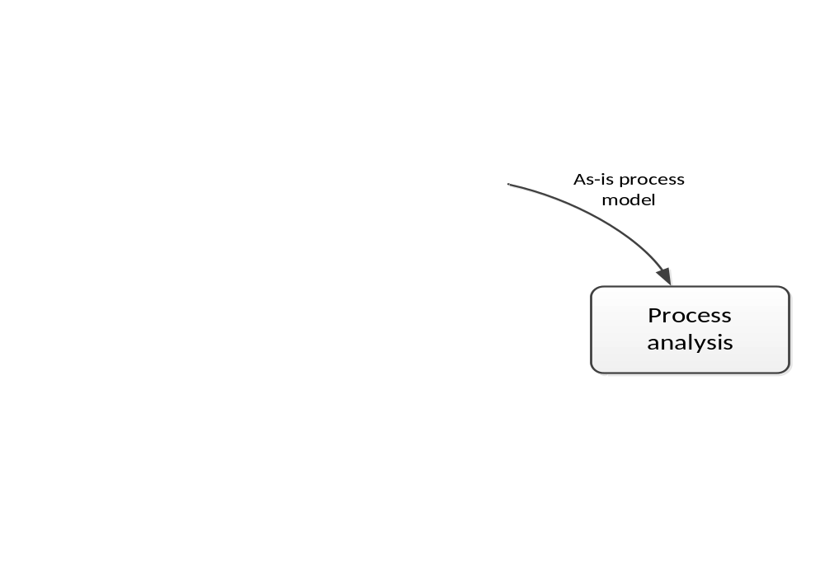
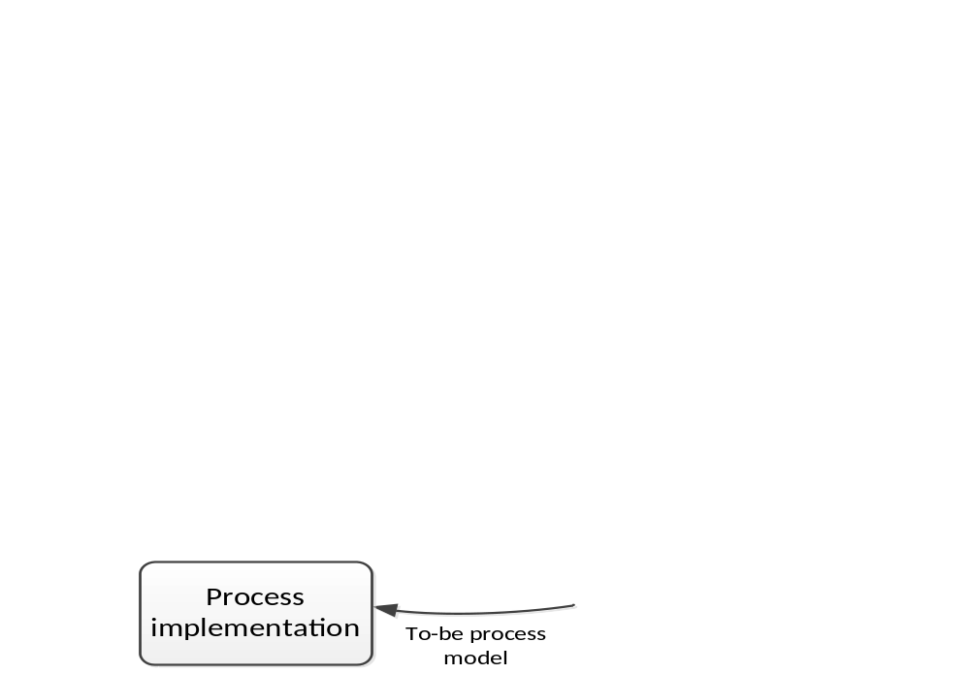

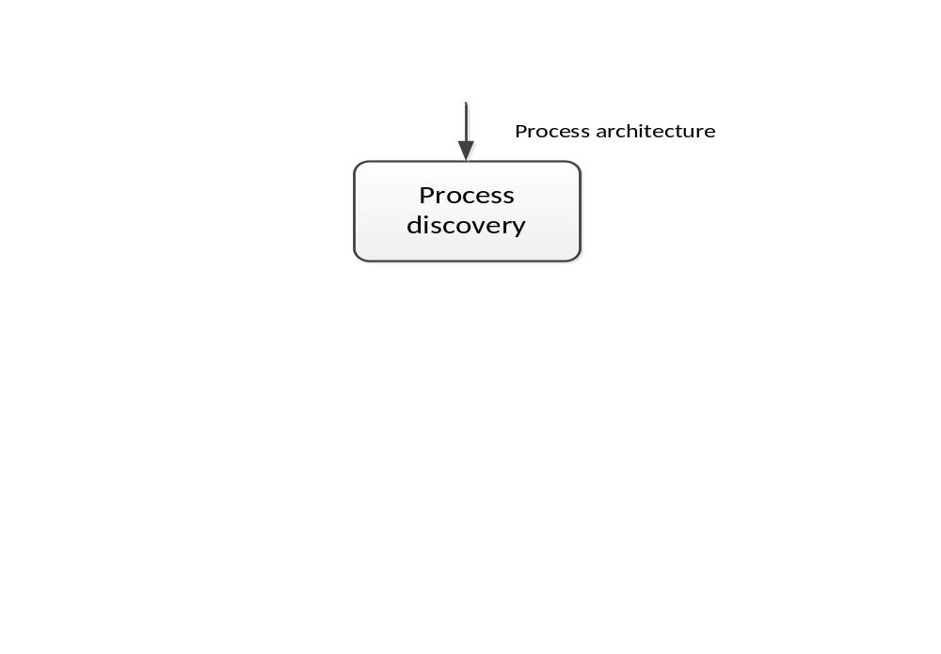
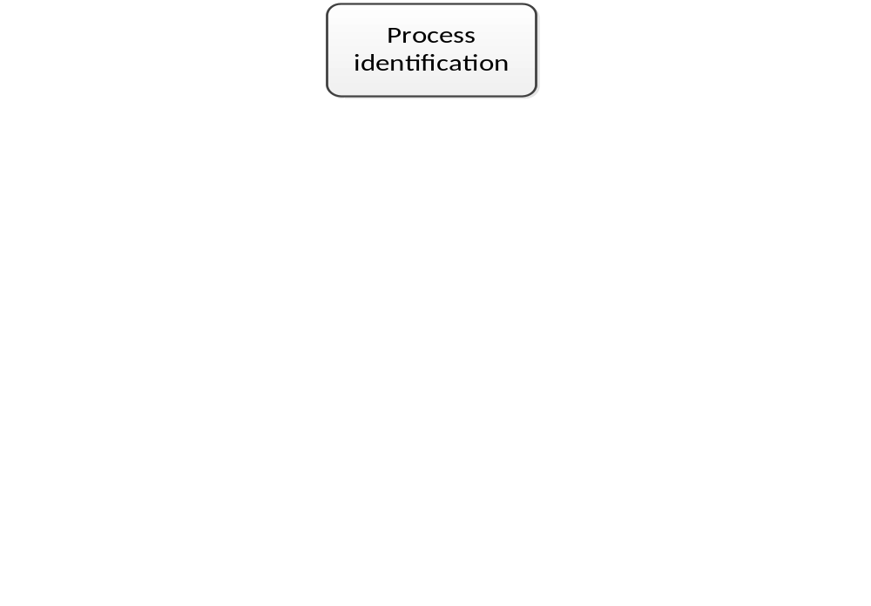
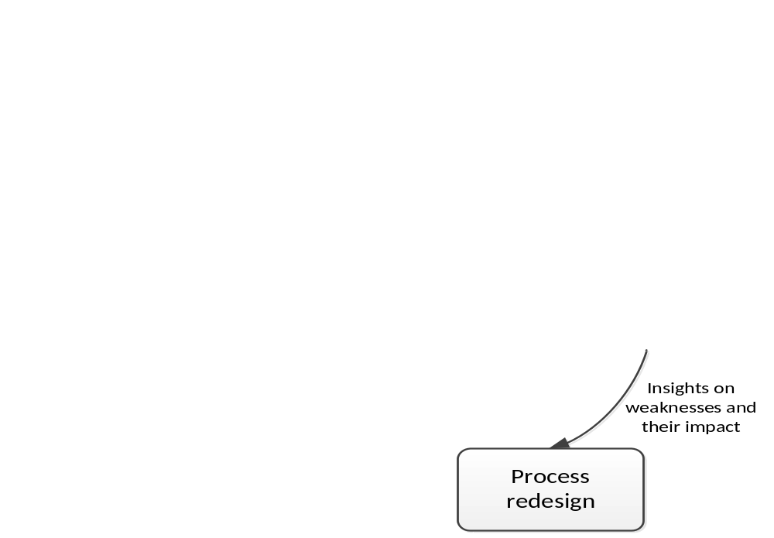
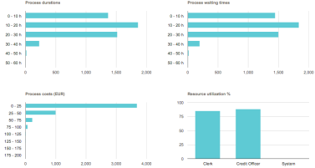

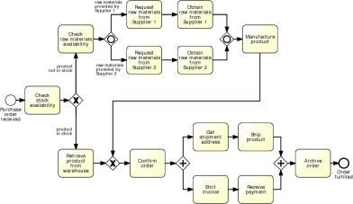
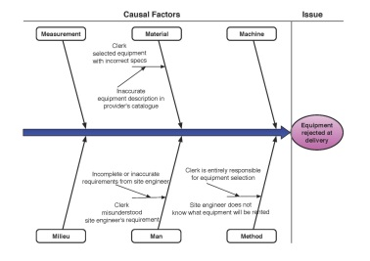
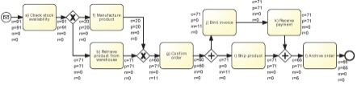
BPM Lifecycle
چرخه حیات فرایند کسب وکار

Slide 7
مشخص کردن یا تعیین فرایند ها یعنی چه؟ Process identification
Process identification is a set of activities aiming to systematically define the set of business processes of a company and establish clear criteria for prioritizing them.
معماری فرایند
The output of process identification is a process architecture, which represents the business processes and their interrelations.
A process architecture serves as a framework for defining the priorities and the scope of process modeling and redesign projects. .

Slide 8
دوفاز تشخیص و ارزیابی در حوزه معماری فرایند ها designation and evaluation
در فاز تشخیص لیست اولیه ای از فرایند ها مشخص و تعریف می شود.
در فاز ارزیابی معیار های مناسبی برای الویت بندی فرایند ها بدست می آید. این الویت بندی برای اعمال فعالیت های مدیریت فرایند صورت میگیرد
فعالیت های مدیریت فرایند شامل کارهای(modeling, redesign, automation, monitoring, etc.). است

Slide 9
فاز تشخیص Designation
در یک کسب و کار چه تعداد فرایند را برای مدیریت فرایند در نظر بگیریم ؟
باید دو موضوع قابل مدیریت بودن و تاثیر بر کسب و کار را سنگین و سبک کنیم
a trade-off between impact and manageability.
The smaller the number of the processes , the bigger their individual scope is. If a small number of processes is identified then each of these will cover numerous operations.
Advantage of a large process scope is that it potentially increases the impact one can have with actively managing such a process. The more operations are considered to be part of a process, the easier it will become, for example, to spot opportunities for efficiency gains by rooting out redundant work. On the other hand, a large scope of a business process brings along a range of issues that make it more difficult to manage it as a process:

Slide 10
دو سوال مهم در معماری فرایند
(i) what processes are executed in the organization?
(ii) which ones should the organization focus on?
needs to keep a map of processes and
Clear criteria for determining which processes have higher priority.
مدیریت و اجرای فرایند ها ذینفعان زیادی دارد اما فقط تعداد انگشت شماری از آنها به صورت کلان و کلی تمام فرایند های سازمان را می شناسند . برای تعیین فرایند ها به دانایی ( دانش ) روشن و دقیقی در مورد فرایند ها نیازمندیم.
هدف فاز تشخیص فرایند ها این است که چنین دانشی استخراج شود و همواره به هنگام نگاه داشته شود

Slide 11
معمولا در یک سازمان چند فرایند مدیریت می شوند؟
Multi-national investment firm: 3,000 staff, Aassets € 300 billion, 120 different business processes
To each of these business processes a process owner is assigned, who oversees the performance of the process and monitors the achievement of its objectives in terms of customer satisfaction, profitability, and accountability.
For a small medical clinic in the Netherlands, which employs medical specialists, nurses, and administrative staff, 10 different treatment processes have been identified. A few of these have been mapped in the form of process models and are now in the process of being automated with a business process management system.

Slide 12
تمرین دسته جمعی در کلاسExercise 2.2
شرکت سرمایه گذاری بین المللی را در مثال قبل در نظر بگیرید. به نظر شما پتانسیل و توانمندی هایی این شرکت که او را قادر کرده است تعداد زیادی از فرایند هایش را مدیریت کند، چیست؟
What are the potential drivers for the described investment firm to identify a large number of processes?

Slide 13
تمرین دسته جمعی در کلاسExercise 2.3
بحث و گفتگو کنید تا چه حد مدیریت سفارش ممکن است به صورت سری و پشت سر هم به کارهای ذیل مرتبط است؟
booking, billing, shipment, and delivery

Slide 14
تمرین دسته جمعی در کلاس
Exercise 2.4 At this point, we discussed hierarchical and sequential relations between business processes. Can you think of other types of relation that are useful to distinguish between processes? As a hint, you might want to think about the purpose of identifying the relations between business processes.

Slide 15
فاز ارزیابی evaluation
چه فرایندی برای مدیریت فرایند الویت دارد
فرایندی برای مدیریت فرایند الویت دارد که از یک سو اثر بسیار زیادی در اهداف استراتژیک کسب و کار دارد و از سوی دیگر از همه فرایند ها بیشتر مشکل دارد و همچنین شرایط سازمانی و فرهنگ شرکت برای مدیریت آن فرایند از همه آماده تر است

Slide 16
فاز ارزیابی evaluation
معیارهای ارزیابی فرایند
Importance To find out which processes have the greatest impact on the company’s strategic goals, for example considering profitability, continuity, or contribution to a public cause.
Dysfunction A high-level judgment of the “health” of each process. which processes are in the deepest trouble?
Feasibility How susceptible they are to process management initiatives, either incidental or on a continuous basis. Most notably, culture and politics involved in a particular process may be obstacles to achieve results from such initiatives.

Slide 17
ارزیابی فرایند ها به صورت پویا(نه فقط یکبار) انجام می شود
انتخاب مجوعه محدودی از فرایند ها و کسب تجربه در طول زمان
Most companies choose to address a small set of business processes in order to gain experience with innovation initiatives, and they focus their resources on the most critical processes. Each successful initiative becomes a model for future efforts

Slide 18
مدل بلوغ فرایند
انتخاب مجوعه محدودی از فرایند ها و کسب تجربه در طول زمان
Level 1 (Initial): At this initial stage, the organization runs its processes in an ad-hoc fashion, without any clear definition of these processes. Control is missing.
Level 2 (Managed): At this stage, project planning along with project monitoring and control have been put into practice. Measurement and analysis is established as well as process and product quality assurance.
Level 3 (Defined): Organizations at this stage have adopted a focus on processes. Process definitions are available and organizational training is provided to enable stakeholders across the organization to be engaged in process documentation and analysis. Integrated project and risk management are in place. Decision analysis and resolution are also in place.
Level 4 (Quantitatively Managed): At this stage, organizational process performance is tracked. Project management is performed using quantitative techniques.
Level 5 (Optimizing): At this stage of maturity, the organization has established organizational performance management accompanied with causal analysis and resolution.

Slide 19
معماری فرایند خروجی فعالیت تعیین (Identification) فرایند است.
Process Identification
معماری فرایند

Slide 20
Designing a Process Architecture
معماری فرایند یک مدل مفهومی که فرایند های یک کسب و کار را نشان می دهد و ارتباط این ففرایند ها را روشن وملموس می کند
Process Identification
معماری فرایند
معماری فرایند خروجی فعالیت تعیین (Identification) فرایند است.
در مدل مفهومی این ارتباط در دو بعد تشریح می شود
In a consumer–producer relationship.
In different levels of detail.

Slide 21
بعد اول در مدل مفهومی
رابطه مشتری- تولید کننده
. هر فرایند نوعی خروجی تولید می کند که ورودی فرایند دیگری است
مثلا فرایند دو » بررسی تا سفارش» و «سفارش تا پرداخت « را در نظر بگیرید . خروجی فرایند اول ورودی فرایند دوم است
This means that one process provides an output that the other process takes as an input.
“quote-to-order process” and “order-to-cash processes” . The output of the first one (the order) is the input to the second one. Note that this is the same kind of ordering as the upstream-downstream relation a process

Slide 22
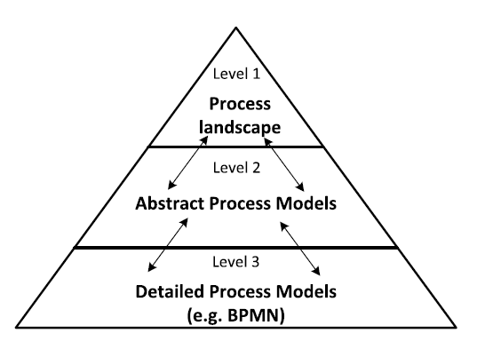
روشن سازی و تبیین جزییات است
بعد دوم در مدل مفهومی
سه لایه جزییات

Slide 23
رویکرد دو بعدی Dijkman برای تشخیص فرایند های سطح اول
An approach developed by Dijkman [14].
This specific approach leads to a process architecture on level one along two dimensions: case type and business function.
The case type dimension classifies the types of cases that are handled by an organization.
A function is, simply put, something that an organization does. For example, purchasing, production, and sales functions. The purchasing function, in turn, can be decomposed into vendor selection and operational procurement functions

Slide 24
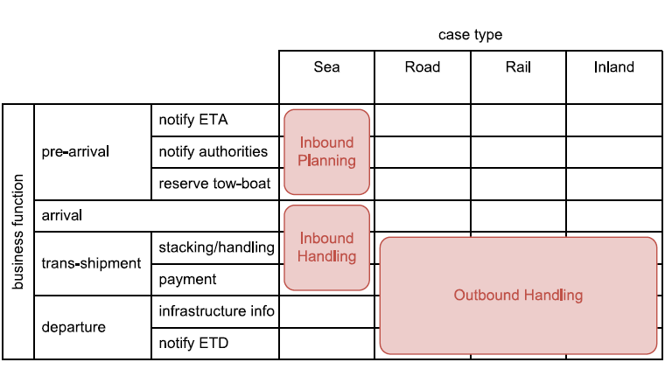
مثال : برای شناخت دو بعد رویکرد Dijkman
(خدمات بندری)

Slide 25
رویکرد معماری کسب و کار
Identify case types
Identify functions for case types
Construct one or more case /function matrices, and
Identify processes

Slide 26
مرحله اول
Identify Case Types
؟
چه موضوعاتی می توانند برای CASE در نظر گرفته شوند

Slide 27
موضوعاتی که می توانند برای CASE در نظر گرفته شوند
Product type: Types of products that . For example, an insurance company
  Damages Insurance (Car insurance and Home insuranc)
  Life insurance (Healthcare insurance and Accident insurance.)
Service type: if (a part of) an organization handles services rather than products
Channel: channel through which the organization contacts its customers. face-to-face contact (over the counter), telephone or internet contact.
Customer type: Types of customer that the organization deals with. An airline, for example, may distinguish frequent flyers from regular travelers.

Slide 28
در انتخاب case مناسب باید به چه چیزی توجه کنیم مهم است
The only properties that should be included in the classification are the ones that lead to different organizational behavior.
Properties that may distinguish cases yet do not lead to different behavior should not be included.

Slide 29
تمرین دسته جمعی در کلاس
Exercise 2.5 Consider the case of a bank and the classification criteria product type, service type, channel, and customer type. In how far are these criteria related to each other?

Slide 30
مرحله دوم:
Identify Functions for Case Types
Potentially, the functions can be related to existing classifications that are proposed by reference models
Several so-called reference models exist. These are developed by a range of industry consortia, non-profit associations, government research programs and academia. The best-known examples are the
Information Technology Infrastructure Library (ITIL),
The Supply Chain Operations Reference Model (SCOR) by the Supply Chain Council
The Process Classification Framework (PCF) by the American roductivity and Quality Center (APQC)
The Value Reference Model (VRM) by the Value Chain Group
The Performance Framework of Rummler–Brache. Reference models standardize

Slide 31
مدل های مرجع کافی نیست
Whether this identification of functions starts with a reference model or not, it requires interviews with different people in the organization.
These interviews serve to either identify the functions directly, or to check to which extent the functions from a reference model apply to the organization.
The interviews must both be held with employees that are involved in the different cases that the organization handles and with product (and service) managers of the different products and services

Slide 32
برخي از دشواري ها در تشخیص فانکشن
Different people involved may very well use different terms for similar business functions.
Homonyms and synonyms are problematic in this context. For example, what is called ‘acquisition’ in one part of the organization may be called ‘market survey’ in another (synonym). At the same time, two functions called ‘implementation’ may represent different activities: one may represent the implementation of software, while the other represents the implementation of new regulations in the organization (homonym).
غيراز ترم هاي مختلف فهم دقيق کار نيز مهم است. مدل هاي مرجع به فهم عمليات کمک مي کند tintricate understanding of the operations of an organization is important to sort these issues out. Frameworks like APQC’s PCF can help organized differently.

Slide 33
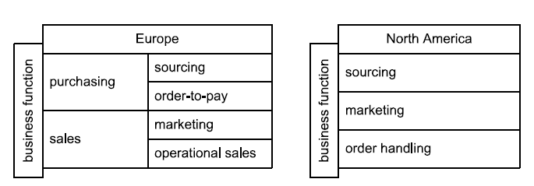
مثال فرق اروپا و آمريکا در برخي فانکشن ها

Slide 34
اشتباه نکنيد
A functional decomposition should not be confused with a decomposition according to case
گاهي ممکن است در سطوح پايينتر مديريت مطابق منطقه جغرافيايي تقسيم شود نبايد اين موضوع را در جداسازي فانکشن در نظر بگيريم
An organization can be structured according to business functions into a sales and a procurement department with managers leading each of the departments. It can be further structured according to location, having both a sales and a procurement department in Europe as well as in North America.
مثال

Slide 35
جدا سازي فانکشن ها تا چندسطح بايد ادامه يابد
In theory, the functional decomposition can be performed up to a level that represents the tasks that are performed by the individual employee (fill-out form, check correctness of information on form, have colleague check correctness of information on form, etc.).
However, a more coarse level of decomposition is usually chosen.

Slide 36
دو قاعده براي توقف جداسازي فانکشن ها
Should at least be performed down to a level at which functions correspond to different organizational units (with corresponding managers).
The functional decomposition should include different functions for the different roles in each department. For example, if the sourcing department has buyers, who do requirements analysis and vendor selection, as well as senior buyers, who do vendor relationship management and contract management,
requirements analysis,
vendor selection,
vendor relationship management
contract management as functions.

Slide 37
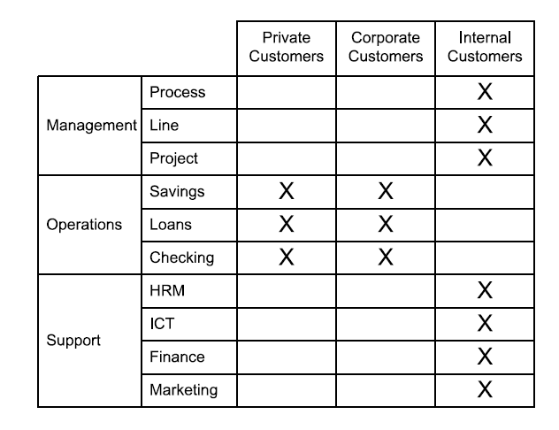

Slide 38
تمرین دسته جمعی برای مرحله دوم رویکرد تشخیص Functions
Exercise 2.6 Consider the case of a university and the level one processes listed in the APQC’s PCF. What kind of more specific functions does a university typically cover in categories 2.0 Develop and Manage Products and Services and in 5.0 Manage Customer Service?

Slide 39
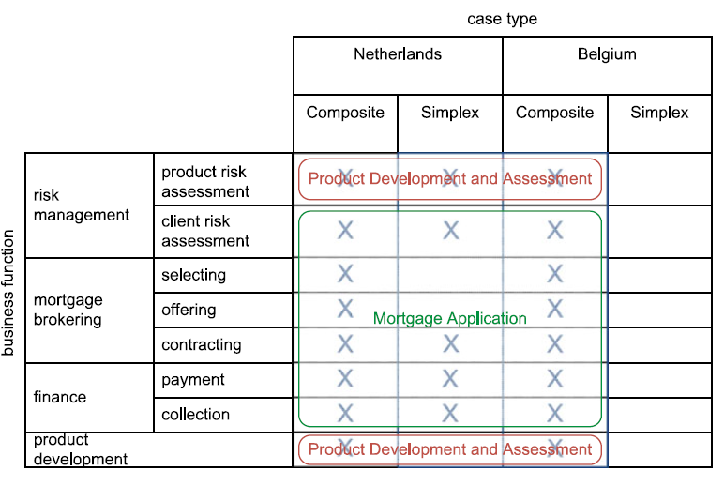
مرحله سوم رویکرد
Construct Case/Function Matrices

Slide 40
مرحله 4 رویکرد
Identify Processes
Trade-off between two extremes, one in which the entire matrix forms one big process and one in which each single cross in the matrix forms a process.
General rule that, in principle, the entire matrix forms one big process
Other rules can be formulated as eight guidelines for separation of processes
Between rows (a vertical split) (Guidelines 5, 6, and 8)
Between columns (a horizontal split). (Guidelines 1–4) .
Guidelines are not absolute: they may or may not apply to a particular organization
They are not the only rules that should be considered in specific cases

Slide 41
Guideline 1:
Different flow objects, it can be split up vertically.
تعريف flow object
A flow object is an object in the organization that flows through a business process. It is the object on which business process activities are being carried out. Typically, each business process has a single flow object, such that flow objects can be used to identify business processes. Consequently, if multiple flow objects can be identified in a business process, this is a strong indication that the process should be split up.

Slide 42
Guideline 1:
مثال: دو جريان شي در فرايند اعطای وام
One flow object for the mortgage brokering process is a mortgage application on which activities are carried out during a mortgage application by a client. These activities include a risk assessment and paying out the mortgage to the client.
Another flow object in the mortgage brokering process is a mortgage product on which activities are carried out periodically to assess the risk of the product as a whole and to evaluate and develop the product.
Consequently, we can split up the mortgage brokering process into two processes, one that has a mortgage application as a flow object and one that has a mortgage product as a flow object. We call the former the mortgage

Slide 43
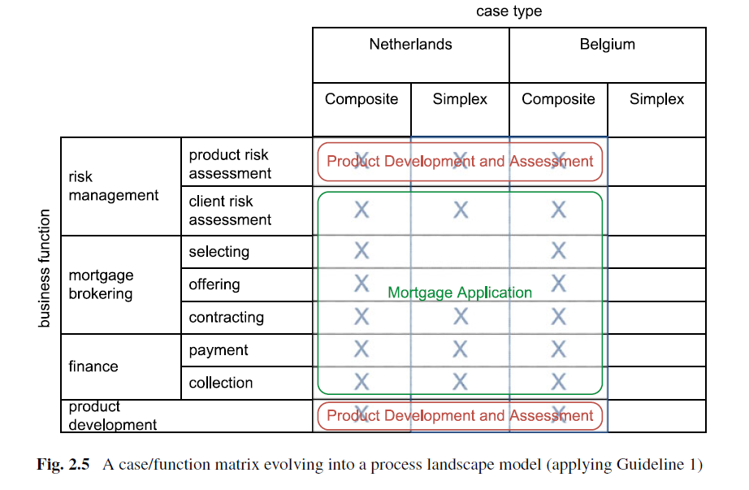
مثال براي راهنماي شماره 1

Slide 44
Guideline 2
If the flow object of a process changes multiplicity, the process can be split up vertically
. This is due to the fact that in a business process a single flow object is sometimes used, while at other times multiple flow objects of the same type are used.

Slide 45
Guideline 2 مثال
at Fig. 2.5, the mortgage application process is performed for a single mortgage application.
چون جمع آمری پرداخت اقساط به صورت دسته ای در هر ماه انجام می شود . بر اساس راهنمای 2 جمع آوری اقساط ماهیانه می تواند فرایندی جدا باشد

Slide 46
Guideline 3
If a process changes transactional state, it can be split up vertically.
تغییرحالت (State)
initiation state : contact between a customer and a provider is initiated
Negotiation State: negotiate about the terms of service or delivery of a product
execution state: provider delivers the product or service to the customer
acceptance state. Negotiate about acceptance and payment of delivery
According to the action-workflow theory, a business process goes through a number of transactional states.
Negotiate about the selection of mortgage products, ultimately leading to a contract being signed by both parties. Only during the execution state the mortgage is paid out to the customer and the monthly payments will be collected.
بر اساس راهنمای 3
Split up the process into a Mortgage application process and a Mortgage payment process.

Slide 47
Guideline 4:
If a process contains a logical separation in time, it can be split up vertically
if its parts are performed at different time intervals :
once per customer request,
once per day, once per month and once per year. , .
Mortgage selection, offering, and contracting are performed once per mortgage application, while payment and collection for mortgages is performed once per month.
بر اساس راهنمای 4
split up mortgage selection, offering, and contracting from mortgage payment collection

Slide 48
Guideline 4:
Note that the passing of time in itself is not a reason for splitting up a process, because within each single process, time passes.
For example, between the activity of entering mortgage details into a computer system and approval of the mortgage, time passes, but the unit of time remains the same: both activities happen once per mortgage application. Therefore, we would not split up the process between these activities.

Slide 49
Guideline 4
Another way of looking at
The process can be split up, if it must wait for a time trigger or a trigger by a new flow object
مثال
The approval of a mortgage can be performed directly after the mortgage details are entered, without having to wait for a trigger.
However, after having processed the mortgage application, the process must wait for the payment collection date trigger to continue with payment collection.
Therefore, we would split up the process between these functions by the same logic of Guideline 4.

Slide 50
Guideline 5:
If a process contains a logical separation in space, it can be split up horizontally.
it is performed at multiple locations and is performed differently at those locations.
in case a process is performed at different locations within the same country, there is not necessarily a reason to perform it differently at those locations. about their process flow.
Two different locations in different countries. However mortgage payment and collection may be the same in Belgium and the Netherlands.
However, risk assessment, mortgage brokering and product development may differ between the Netherlands and Belgium, due to country-specific rules and regulations.

Slide 51
Guideline 6:
If a process contains a logical separation in another relevant dimension, it can be split up horizontally
Like with the separation in space, it is not sufficient for processes to just be separated.
The separation must be such that there is no choice but to perform the processes differently for the different logical units

Slide 52
Guideline 7:
If a process is split up in a reference model, it can be split up.
A reference process architecture is an existing process architecture that is pre-defined as a best-practice solution.

Slide 53
Guideline 8:
If a process covers (many) more functions in one case type than in another, it can be split up horizontally.
it is necessary to look at the current decomposition of processes and check if, within a process, (many) more functions are performed for one case type than for another
Looking at Fig. 2.6, we see that the Mortgage Application Netherlands process has many more function for composite mortgages than for simplex mortgages.
Split up this process for composite and simplex application
بر اساس راهنمای 8

Slide 54
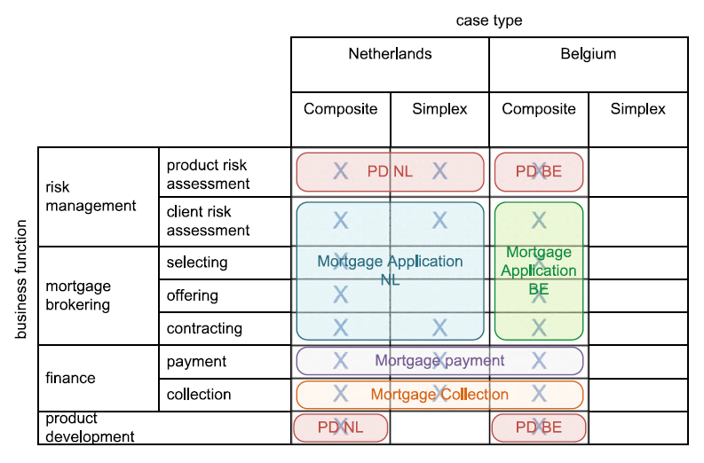
Applying Guidelines 2 through 7
Product Development and Assessment Netherlands (PD NL),
Product Development and Assessment Belgium (PD BE)
Mortgage Application ( NL),
Mortgage Application Belgium,
Mortgage Payment,
Mortgage Collection.

Slide 55
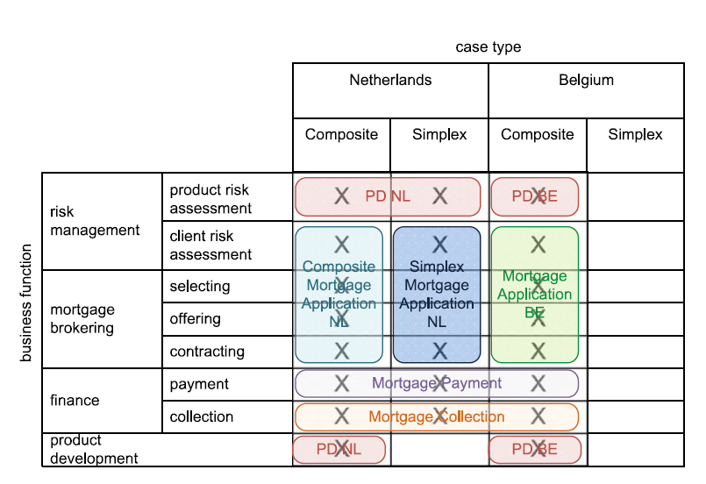
Application of all of 8 guidelines.
Finalized process landscape model for our example.

Slide 56
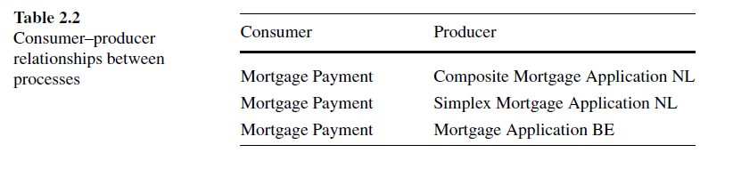
رابطه های مشتری و سرویس دهنده

Slide 57
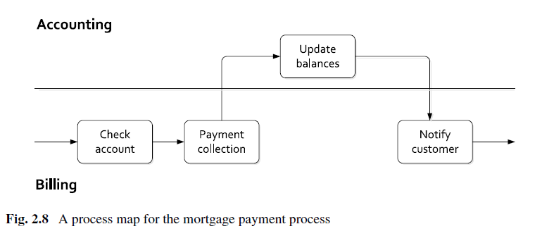
مثال برای سطح جزیی تر (سطح ۲(
Process Map

Slide 58

سؤالات و تبادل نظر
؟

Slide 59
راهنمای مطالعه فصل 2 کتاب
هدف فصل دوم تفهیم مفهوم معماری کسب و کار و ارایه یک متدلوژی برای آن است
لازم است تعدادی فرایند برای مدلسازی و سپس مدیریت انتخاب شوند. فرایند های منتخب در لایه های مختلف از جزییات کم تا جزییات زیاد مدلسازی می شوند. کسب و کار مربوطه بر روی این فرایند ها تسلط دارد و به سادگی می تواند برای آنالیز، بهبود و مدیریت آنها اقدام کند.
بخش اول فصل(2.1) شامل دوقسمت است ، قسمت اول فهمیدن فرایند ها و انتخاب اولیه است و قسمت دوم آنالیز و مقایسه فرایند ها با هم و درک فرایند های مهم است
در قسمت اول ، ابتدا این سوال را طرح می کند که تعداد کمی فرایند وسیع ( دامنه وسیع) را انتخاب کنیم بهتر است یا تعداد زیادتری فرایند کوچکتر ( دامنه محدود)؟ و سپس با استفاده از مدل های مرجع مثل مدلSCOR , ETAM که در کلاس بحث کردیم و یا مدلAPQC( مدل مرکز بهره و ری و کیفیت آمریکا- در سایت این مرکز موجود است – ضمییمه نیز شده است) انتخاب اولیه انجام می شود.در قسمت دوم، تعدادی معیار برای انتخاب نهایی، مثل اهمیت استراتژیک فرایند، مشکل داشتن و بد کارکردن فرایند معرفی می کند و در یک محور دو بعدی فرایند ها با هم مقایسه می شوند
بخش دوم فصل (2.2)در باره معماری فرایند های منتخب است. فرایند های که در بخش اول فهمیده و یا انتخاب می شوند، برچسب های کلی هستند.یعنی آنچه در بخش اول دستگیر ما می شود فهم عمومی فرایند های بیزینس است . باید برای کسب و کار مورد نظر، فرایند ها و ارتباط آنها با هم و با بیزینس مشخص شود..برای اینکار یک رویکرد چهار مرحله ای به شرح ذیل ارایه می دهد .
  1. identify case types
  2. identify functions for case types
  3. construct one or more case/function matrices, and
  4. identify processes
برای مرحله سوم یک متدلوژی به نام ماتریس فانکشین/کیس را ارایه می دهد. برای مرحله چهارم نیز 7Guideline ارایه می دهد. لطفا رویکرد 4 مرحله ای و هفت راهنما را به دقت مطالعه کنید. در کلاس سوال می شود

